Slide 1



QUERY CRUD
Present by Eduwork.id
www.eduwork.id

Slide 2


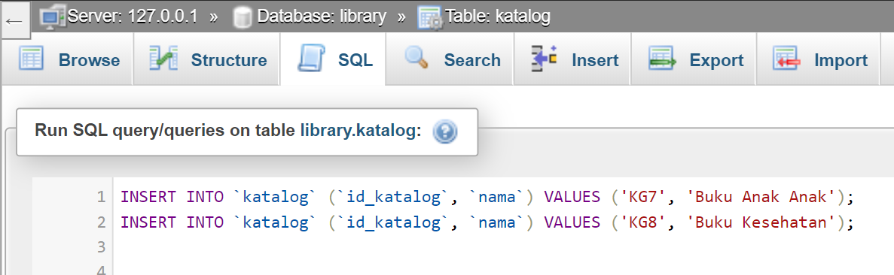
www.eduwork.id | Page 01
Query Insert

Slide 3
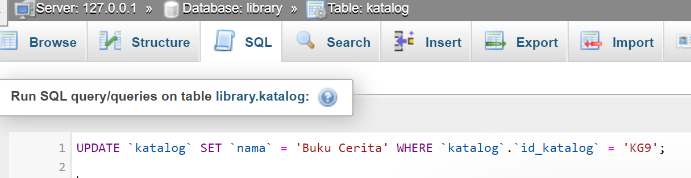
www.eduwork.id | Page 01
Query Update

Slide 4
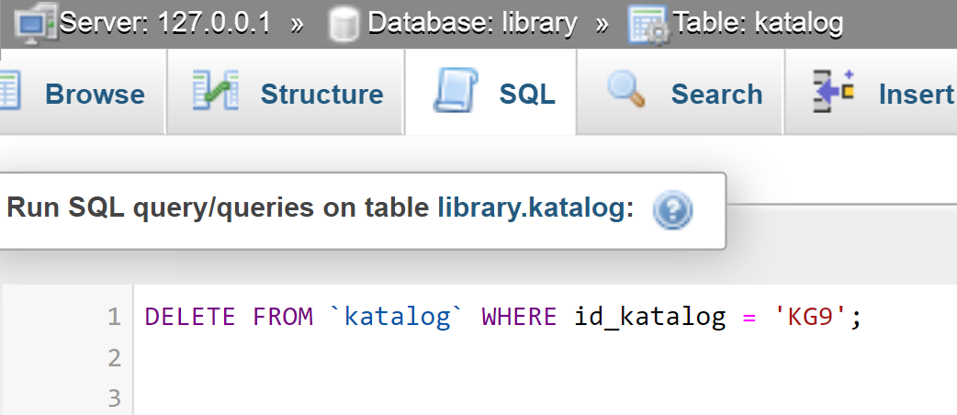
www.eduwork.id | Page 01
Query Delete

Slide 5
QUERY DATA
Present by Eduwork.id
www.eduwork.id

Slide 6
www.eduwork.id | Page 05
Sintaks SELECT
SELECT kolom1, kolom2, .... FROM nama_table; atau SELECT * FROM nama_tabel;
Contoh
SELECT nis, nama, alamat, FROM siswa;
atau
SELECT * FROM siswa;

Slide 7
www.eduwork.id | Page 05
Sintaks WHERE
SELECT kolom1, kolom2, ... FROM nama_tabel WHERE kondisi;
Contoh
SELECT nis, nama FROM siswa WHERE alamat='jakarta';

Slide 8
www.eduwork.id | Page 05
Sintaks AND
SELECT kolom1, kolom2, .... FROM nama_tabel WHERE kondisi1 AND kondisi2 AND kondisi3;
Contoh
SELECT nis, nama FROM siswa WHERE alamat='Jakarta' AND tahun_lahir='2000';

Slide 9
www.eduwork.id | Page 05
Sintaks OR
SELECT kolom1, kolom2, .... FROM nama_tabel WHERE kondisi1 OR kondisi2 OR kondisi3;
Contoh
SELECT nis, nama FROM siswa WHERE alamat='Jakarta' OR tahun_lahir='2000';

Slide 10
www.eduwork.id | Page 05
Sintaks WHERE NOT
SELECT kolom1, kolom2, .... FROM nama_tabel WHERE NOT kondisi1;
Contoh
SELECT nis, nama FROM siswa WHERE NOT alamat='Jakarta';

Slide 11
www.eduwork.id | Page 05
Sintaks ORDER BY
SELECT kolom1, kolom2, .... FROM nama_tabel ORDER BY column DESC;
Contoh
SELECT nis, nama FROM siswa ORDER BY nama DESC;

Slide 12
www.eduwork.id | Page 05
Sintaks MIN
SELECT MIN(nama_kolom) FROM nama_tabel WHERE kondisi;
Contoh
SELECT MIN(harga) FROM nama_tabel WHERE kategori='atk';

Slide 13
www.eduwork.id | Page 05
Sintaks MAX
SELECT MAX(nama_kolom) FROM nama_tabel WHERE kondisi;
Contoh
SELECT MAX(harga) FROM nama_tabel WHERE kategori='atk';

Slide 14
www.eduwork.id | Page 05
Sintaks COUNT
SELECT COUNT(nama_kolom) FROM nama_tabel WHERE kondisi;
Contoh
SELECT COUNT(id) FROM nama_tabel WHERE kategori='atk';

Slide 15
www.eduwork.id | Page 05
Sintaks AVG
SELECT AVG(nama_kolom) FROM nama_tabel WHERE kondisi;
Contoh
SELECT AVG(harga) FROM nama_tabel WHERE kategori='atk';

Slide 16
www.eduwork.id | Page 05
Sintaks SUM
SELECT SUM(nama_kolom) FROM nama_tabel WHERE kondisi;
Contoh
SELECT SUM(qty) FROM nama_tabel WHERE kategori='atk';

